Slide 1
Python week 8
Canberra Chinese School Sem2

Slide 2
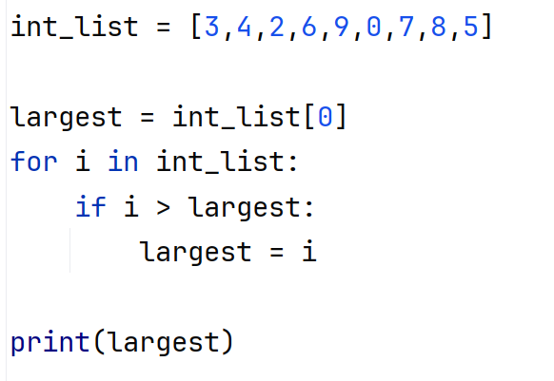

List Algorisms (Review)

Slide 3
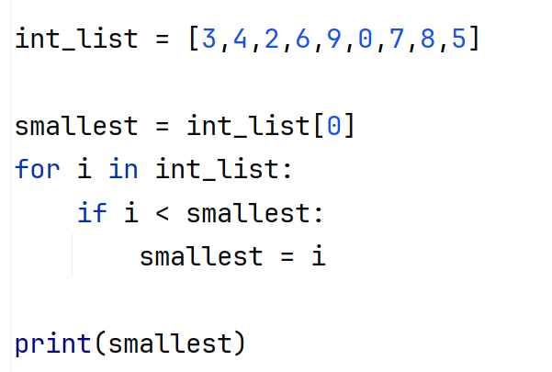
List Algorisms(Review)
Exercise: write a script that finds the minimum of this list

Slide 4
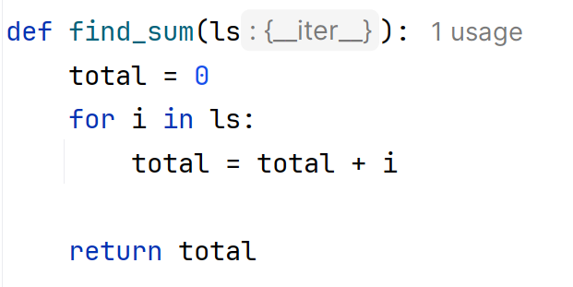
List Algorisms(Review)
Last week’s homework: make a function that finds the sum of a list

Slide 5
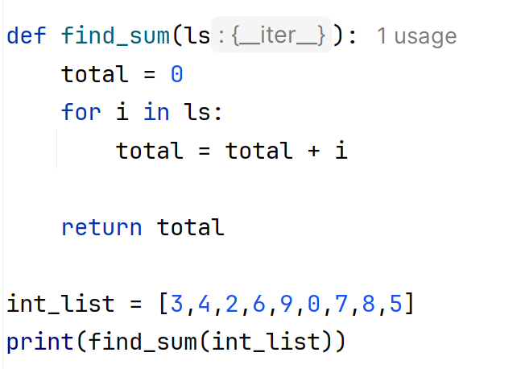
List Algorisms
We can test this function with our int list

Slide 6
List Algorisms(Review)
Exercise: make a function that checks if an item is in a list

Slide 7
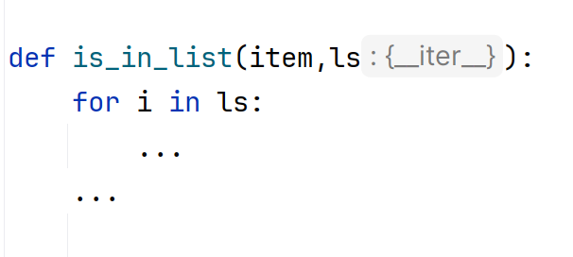
List Algorisms(Review)
Exercise: make a function that checks if an item is in a list

Slide 8
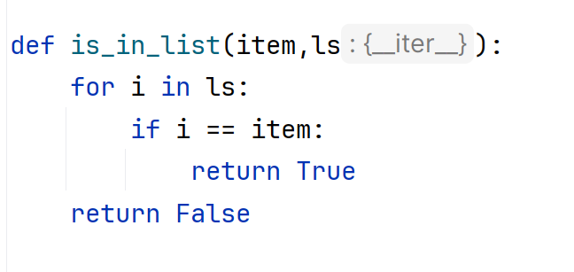
List Algorisms(Review)
Exercise answer

Slide 9

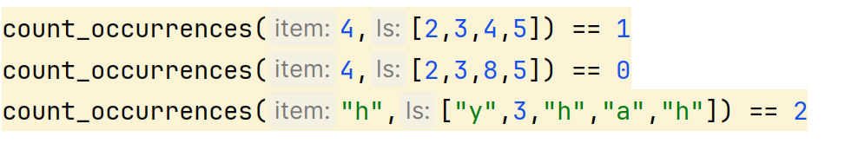
List Algorisms
Challenge: write a function that counts the number of occurrences of an item in a list.
For example

Slide 10
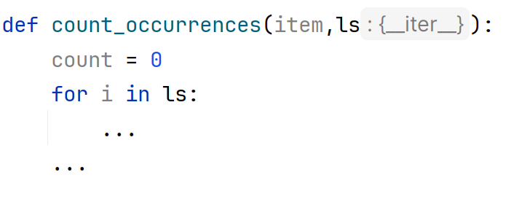
List Algorisms
Challenge: write a function that counts the number of occurrences of an item in a list.
Hint:

Slide 11
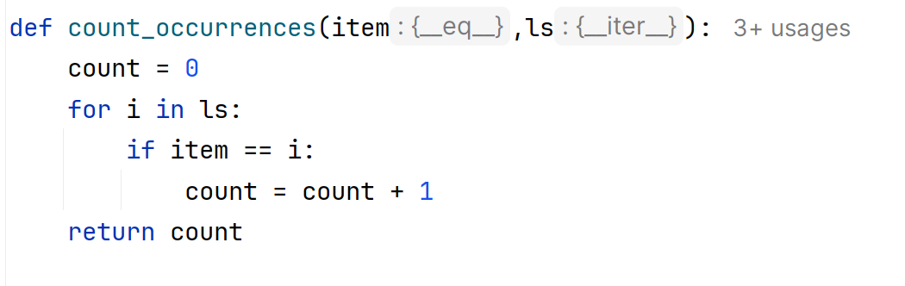
List Algorisms
Challenge answer:

Slide 12
List Algorisms
Let’s do something fun with this function. Let’s say mom went on a shopping spree, and we want to count what she bought.

Slide 13
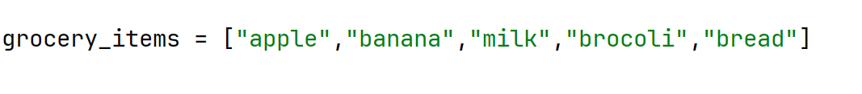
List Algorisms
Let’s do something fun with this function. Let’s say mom went on a shopping spree, and we want to count what she bought.
Let’s make a list of the grocery items.

Slide 14

List Algorisms
Let’s do something fun with this function. Let’s say mom went on a shopping spree, and we want to count what she bought.
Let’s make a list of the grocery items.
Let’s also make a list of items she bought. Let’s make this list empty for now.

Slide 15
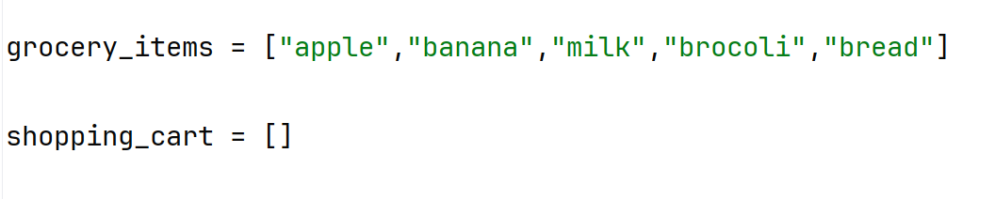
List Algorisms
Then, we want to repeatedly add random items from “grocery-items” to “shopping-cart”, for maybe 100 times.
Try to do this part yourself.

Slide 16

List Algorisms
Then, we want to repeatedly add random items from “grocery-items” to “shopping-cart”, for maybe 100 times.
Remember to
Try to do this part yourself.

Slide 17
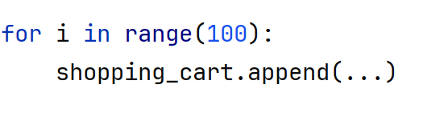
List Algorisms
Then, we want to repeatedly add random items from “grocery-items” to “shopping-cart”, for maybe 100 times.
Hint:

Slide 18
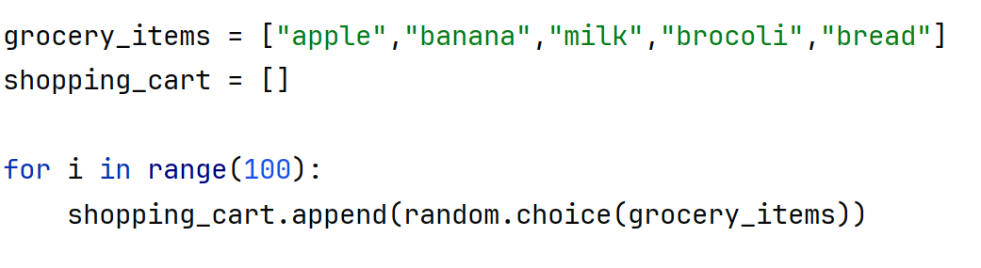
List Algorisms
Then, we want to repeatedly add random items from “grocery-items” to “shopping-cart”, for maybe 100 times.
Answer:

Slide 19
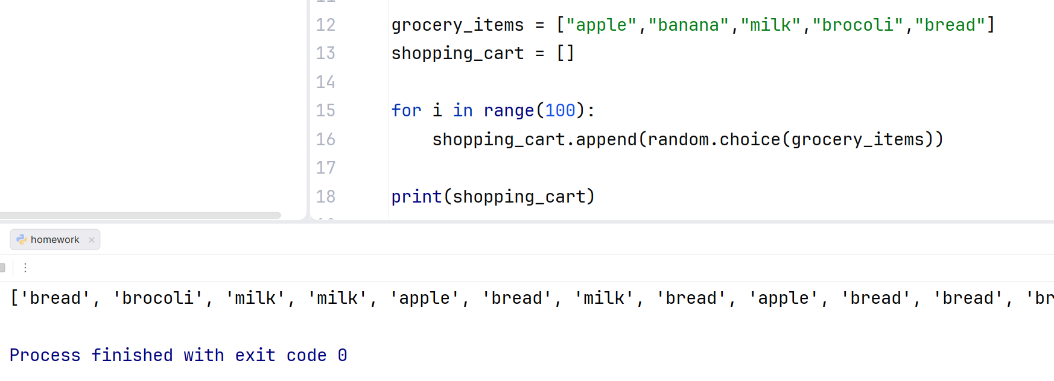
List Algorisms
We can print our resulting shopping-cart out
It’s a really long list!

Slide 20
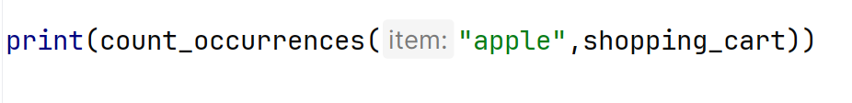
List Algorisms
Remember the “count-occurrences” function we wrote? Now we can use that to count how many of one specific item mom bought.
This prints 22. so mom has bought 22 apples!

Slide 21
List Algorisms
Remember the “count-occurrences” function we wrote? Now we can use that to count how many of one specific item mom bought.
This prints 22. so mom has bought 22 apples!

Slide 22

List Algorisms
Let’s refine this a little bit by labeling “apples” in the end. Notice that we need to convert the result of count-occurrences from int to str
This prints
So this time, mom bought 20 apples.

Slide 23
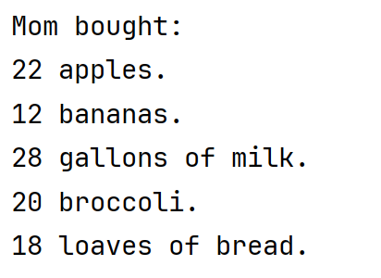
List Algorisms
This prints

